Slide 1
Developing ChatBot 4-1 Review
Refresh-Foods Inc.
Yestin Yehoon Lee

Slide 2
Process of Make New Web App
Conception
Plan
Design
Develop
Test
Launch
Notes:
You can create your own ChatBot by following process

Slide 3


Local tools
nodejs.org/es/download/
Sign up Heroku
Install Heroku Command Line Interface
Notes:
2 local tools needed for developing a ChatBot

Slide 4
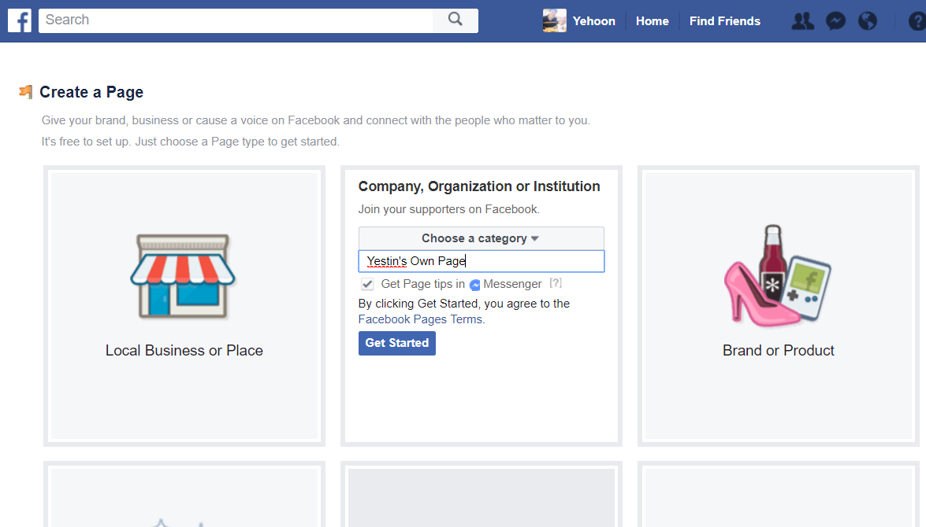


Online Tools / API
Create Facebook page
Create app in Facebook for developers
Create api.ai agent
Notes:
Create Facebook page
Create app in Facebook for developers
Create api.ai agent

Slide 5
Git Setting (1/2)
mkdir dev
cd dev
npm install npm
npm init (entry: app.js)
npm install express
express
request
body-parser
Notes:
Do follow command in Git for initial setting

Slide 6
Git Setting (2/2)
ssh-keygen -t rsa
Enter passphrase
eval $(ssh-agent -s)
ssh-add ~/.ssh/id_rsa
Heroku login
Notes:
https://help.github.com/articles/generating-a-new-ssh-key-and-adding-it-to-the-ssh-agent/
You must remember passphrase what you entered

Slide 7
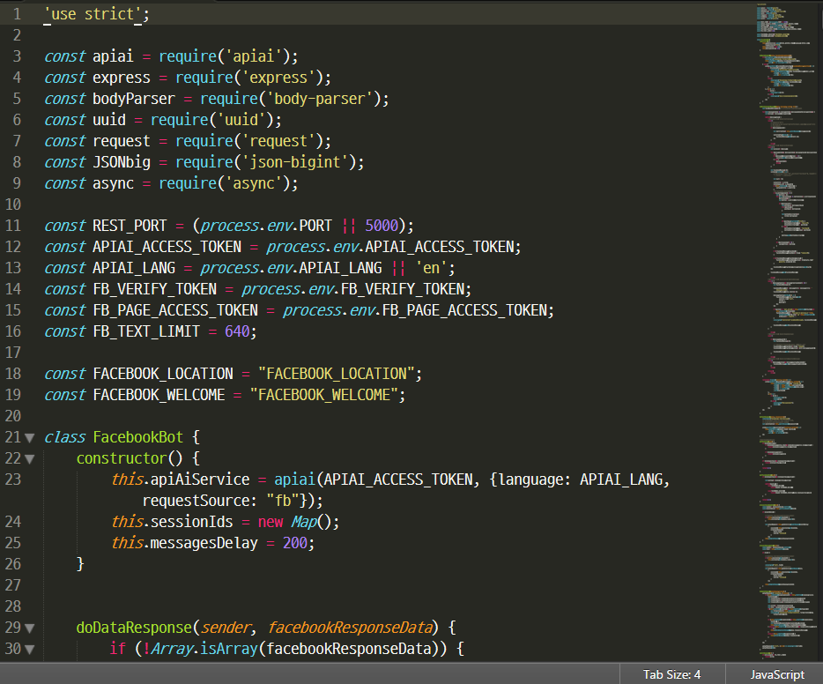
Check Source Code
Downloaded from api-ai
Notes:
https://github.com/api-ai/api-ai-facebook

Slide 8
Initially Push Code to Server
git init
git add .
git commit –m ‘first’
Heroku create app-name
git push heroku master
Notes:
This step is to push code to server initially.
Words in yellow are name.
If you use Git for first time, you have to configure name and e-mail before commit.

Slide 9
Push Code to Server
git add .
git commit –m ‘use api.ai’
git push heroku master
Notes:
When you edit code and push to server again,
you only need to do following 3 commands.

Slide 10

How API.AI Connected
API.AI
Facebook
Local
Heroku
Sendgrid
User
Developer
Server
Email
Twilio
SMS
Notes:
API.AI, Facebook page, Heroku server
are connected with token verify

Slide 11
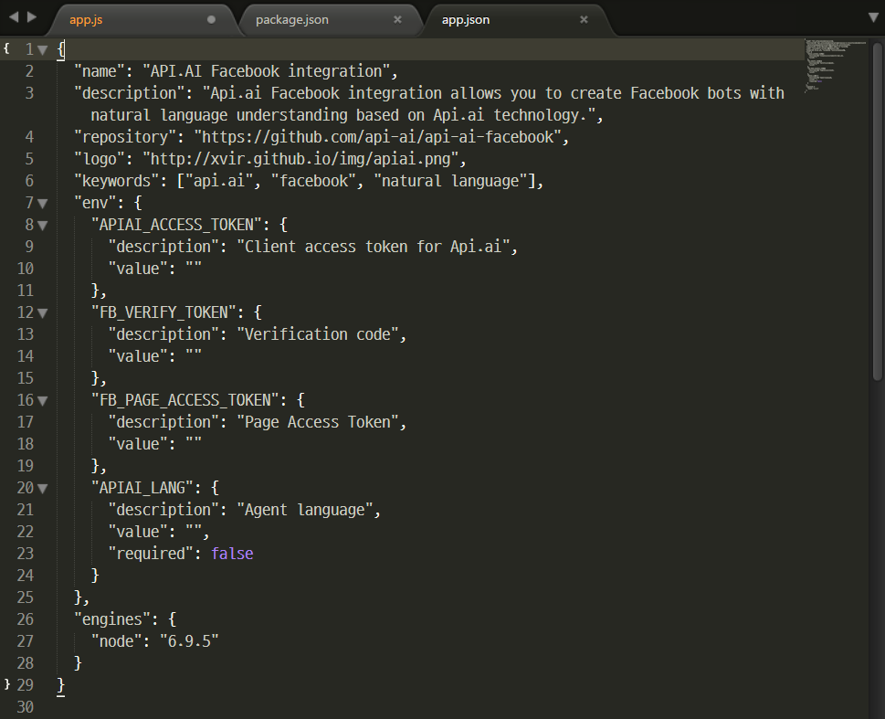
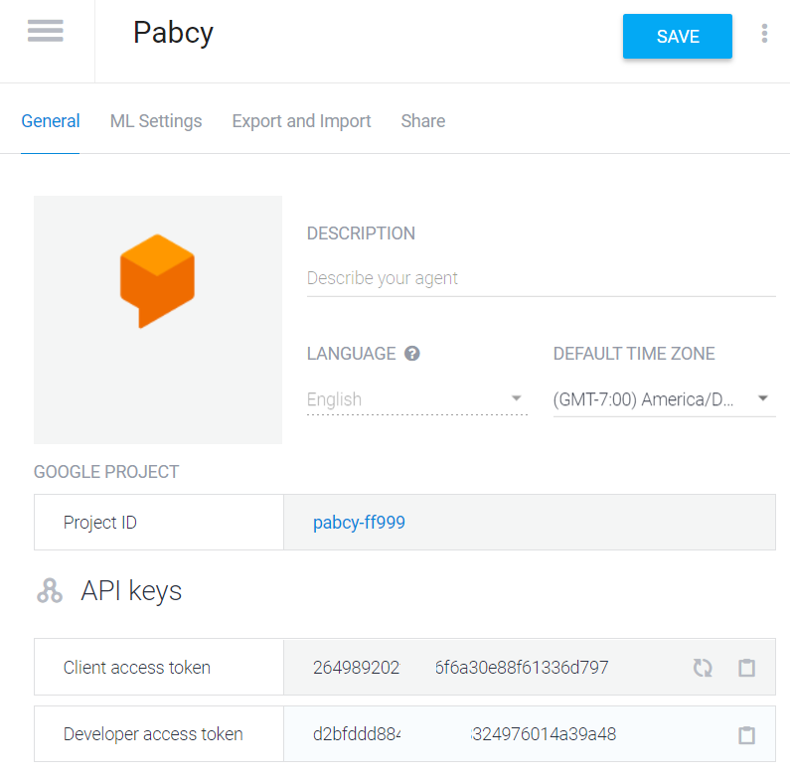
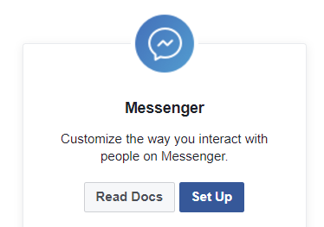
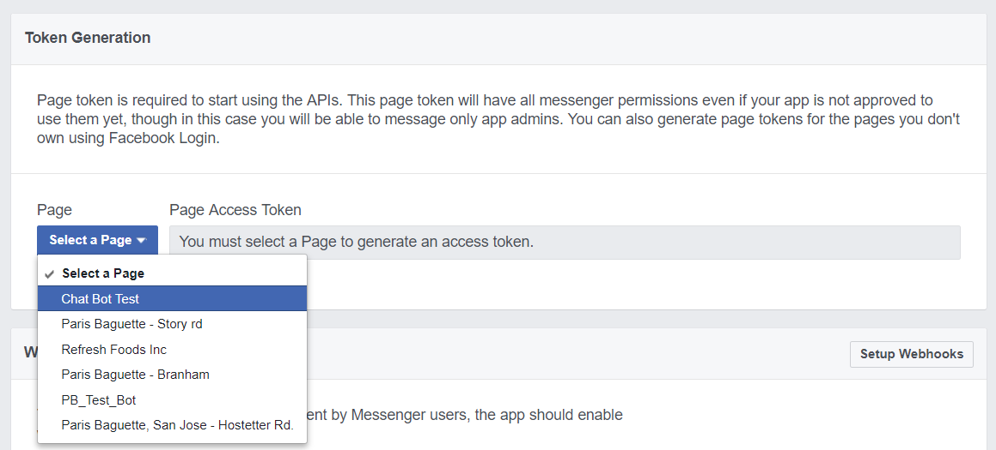
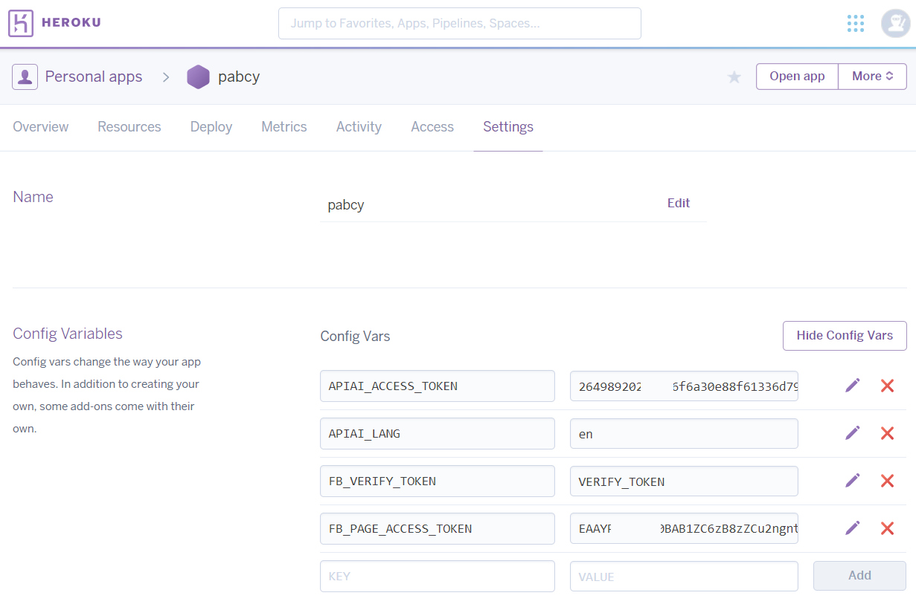
4 config vars in Heroku
Name is in app.json file
APIAI_ACCESS_TOKEN from api.ai agent setting – Client access token
FB_VERIFY_TOKEN “VERIFY_TOKEN”
FB_PAGE_ACCESS_TOKEN go to developer.facebook.com at Messenger setup copy ‘Page Access Token’
APIAI_LANG “en” for English or “es” for Español
Notes:
We need to set 4 config variables.

Slide 12
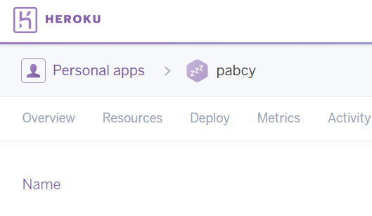

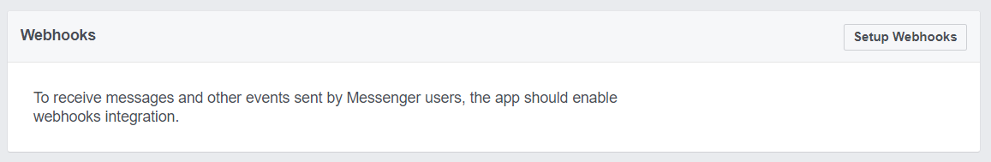
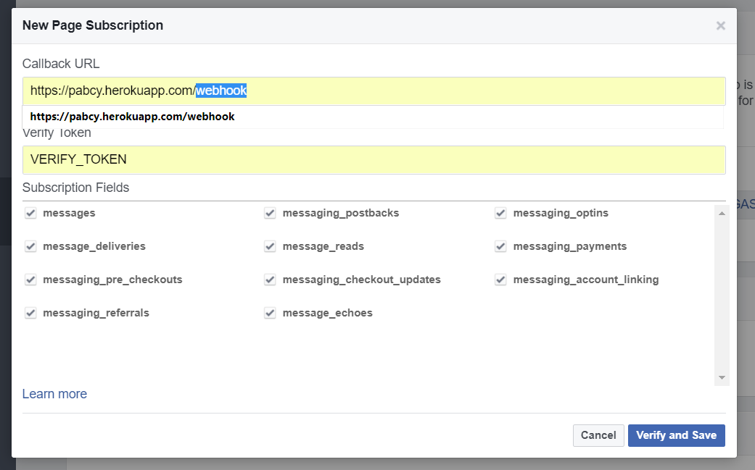
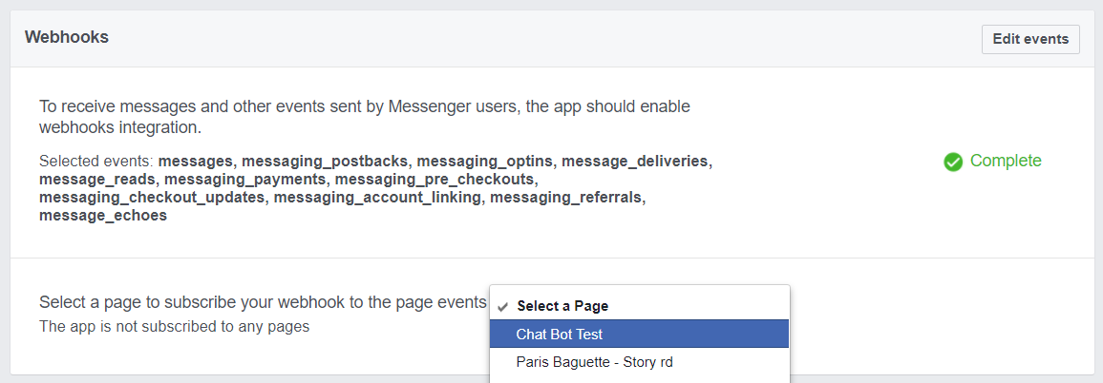
Webhook Setting
Go to Heroku app dashboard - Setting
Copy app domain
Go to facebook app setting Click setup webhooks
Set callback URL as ‘Domain’ /webhook
Set VERIFY_TOKEN
Check all
Select page and subscribe

Slide 13
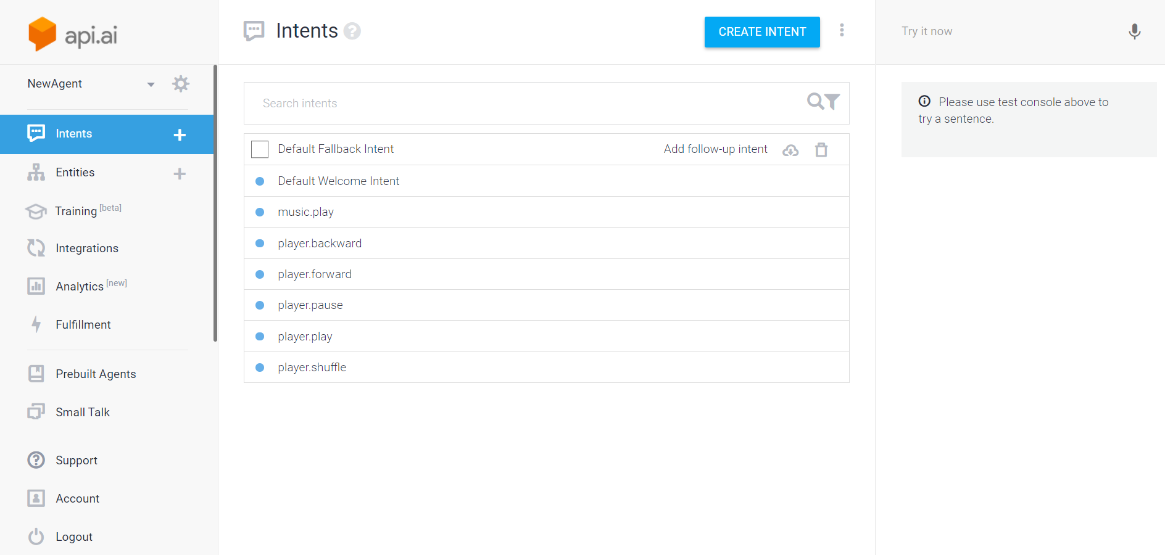
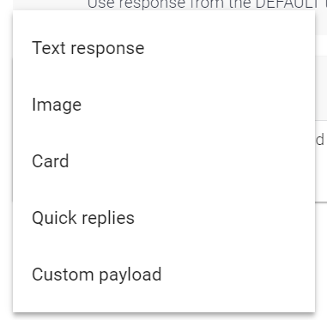
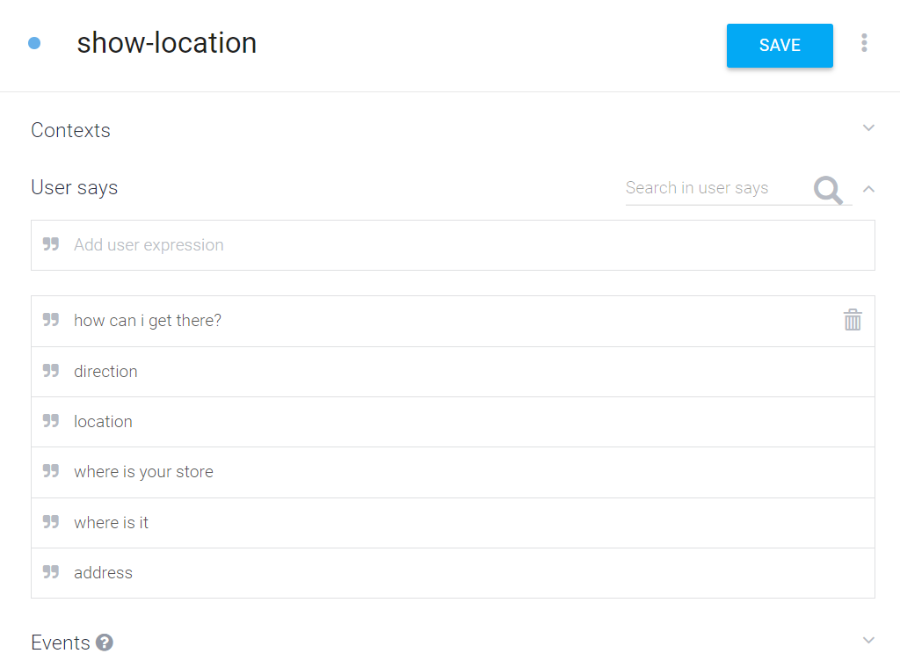
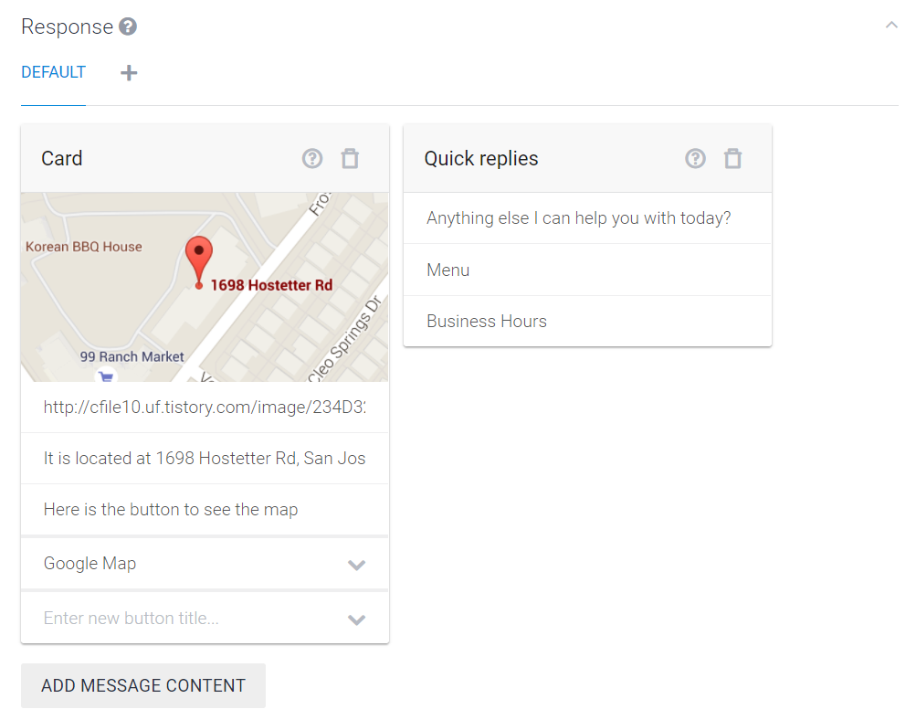
Create Intent
Question
Answer
Notes:
Design question and answer to the question

Slide 14
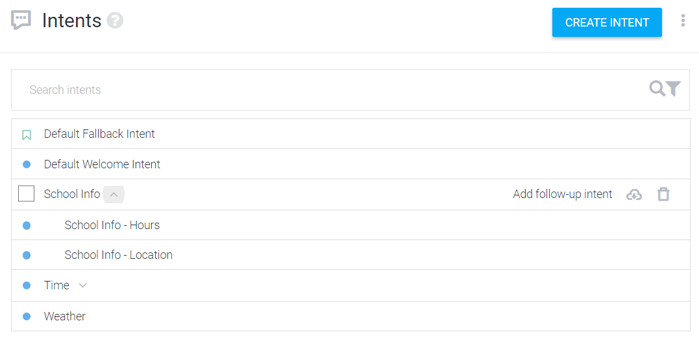
Followup Intent
Used for conversation flow
ex)
A: Are you a human?
B: Yes. (If you say no, it doesn’t go to female question)
A: Are you female?
B: No.

Slide 15




Add-ons
Need to learn JavaScript
Postgres: Heroku database https://devcenter.heroku.com/categories/heroku-postgres
Twilio: Programmable SMS sending https://www.twilio.com/docs
SendGrid: Free sending email by programming. https://sendgrid.com/
PayPal https://developer.paypal.com/docs/api/

Slide 16
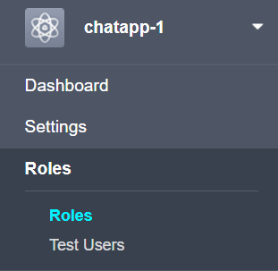
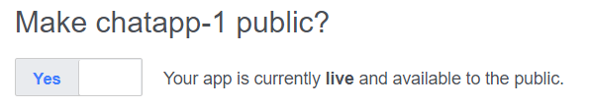
to Launch
Add tester Facebook Developer – Roles – Testers – Add testers
Publish: Facebook Developer – App Review – Make public

